Slide 1
Recursive Least Square (RLS) Method in Parameter Estimation
METU – Arçelik 2244 program
Serhat Ozkucuk

Slide 2
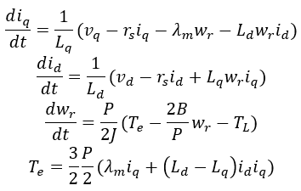
Least Square Method Basic Principle
Physics of the system is known !
It minimizes the sum of squares of the error between
Measured output & Model response

Slide 3

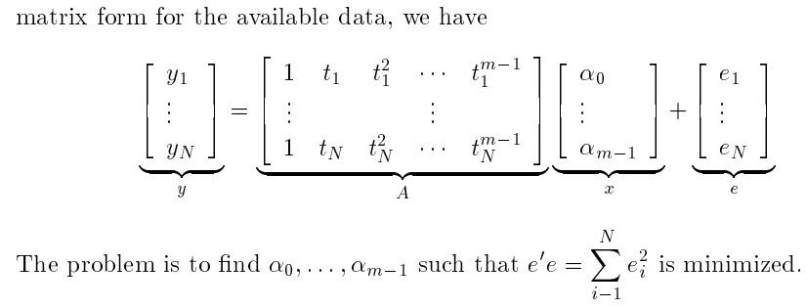
Mathematical formulation (1)

Slide 4


Mathematical formulation (2)
Output yi’s are linearly related with input xi’s
->Equation error
The purpose is minimizing the equation error e.

Slide 5
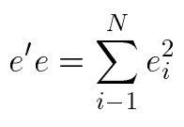


Mathematical formulation (3)
J(x) =
=
‘
( )
( )
d J(x)/dx = 0

Slide 6
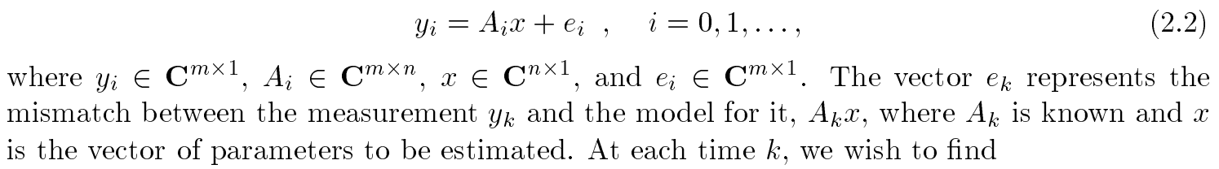
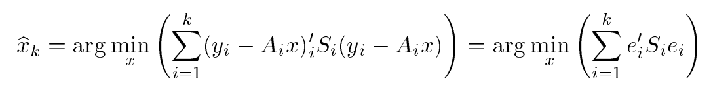
Recursive (Sequential) Least Square Estimation
What if the data is coming in sequentially? Do we have to recompute everything each time a new data point comes in, or can we write our new, updated estimate in terms of our old estimate?

Slide 7
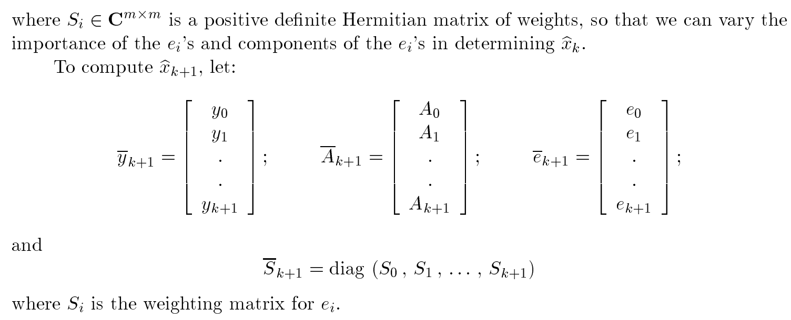

Slide 8
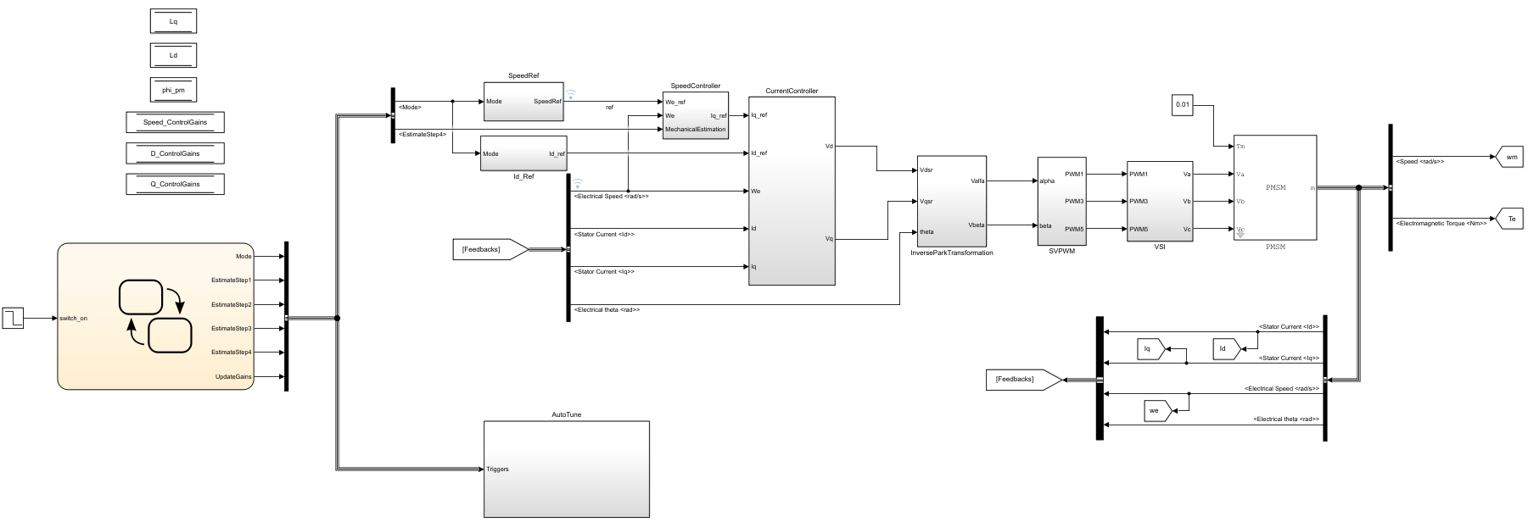
Matlab Model

Slide 9
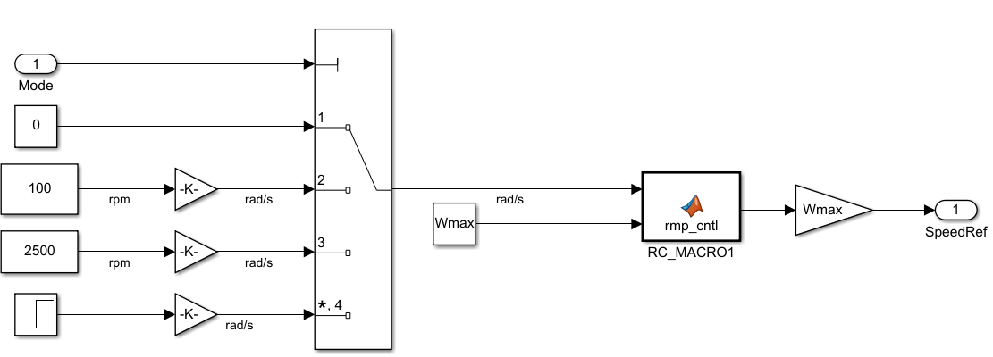
Speed ref

Slide 10
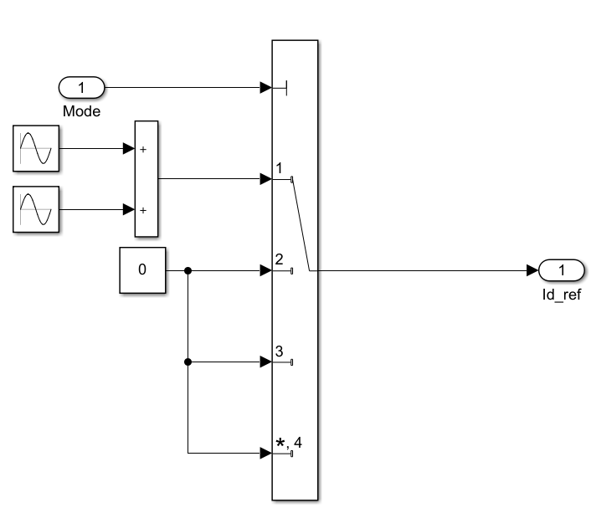
Id ref

Slide 11
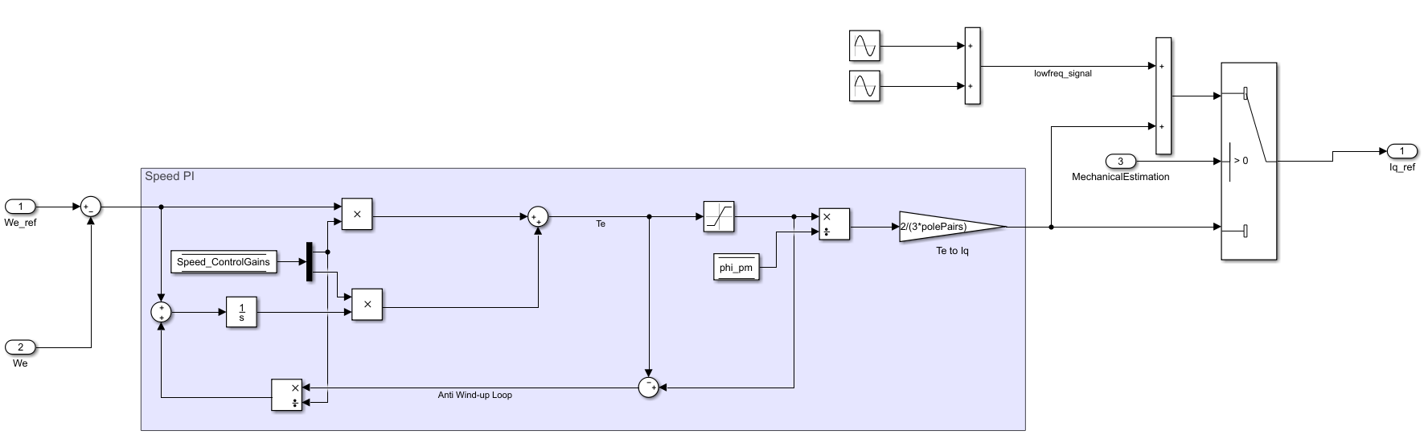
Iq ref

Slide 12
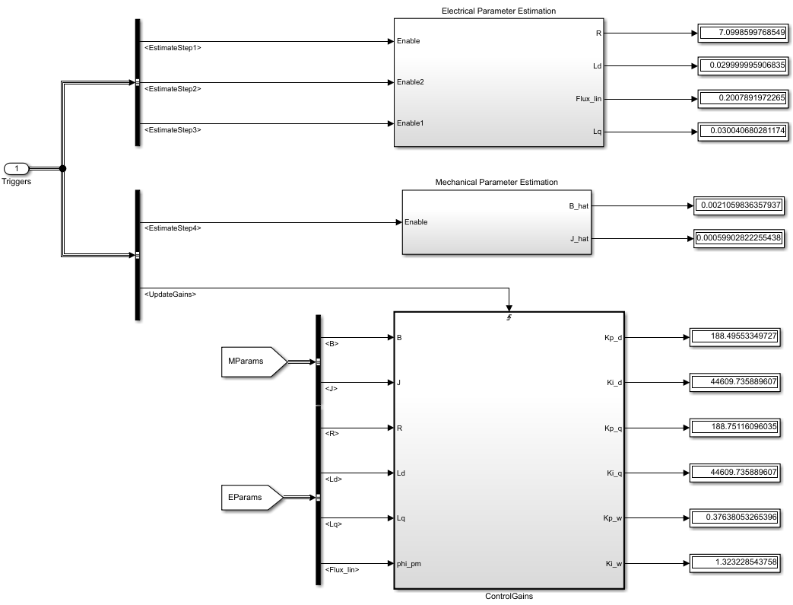

Slide 13
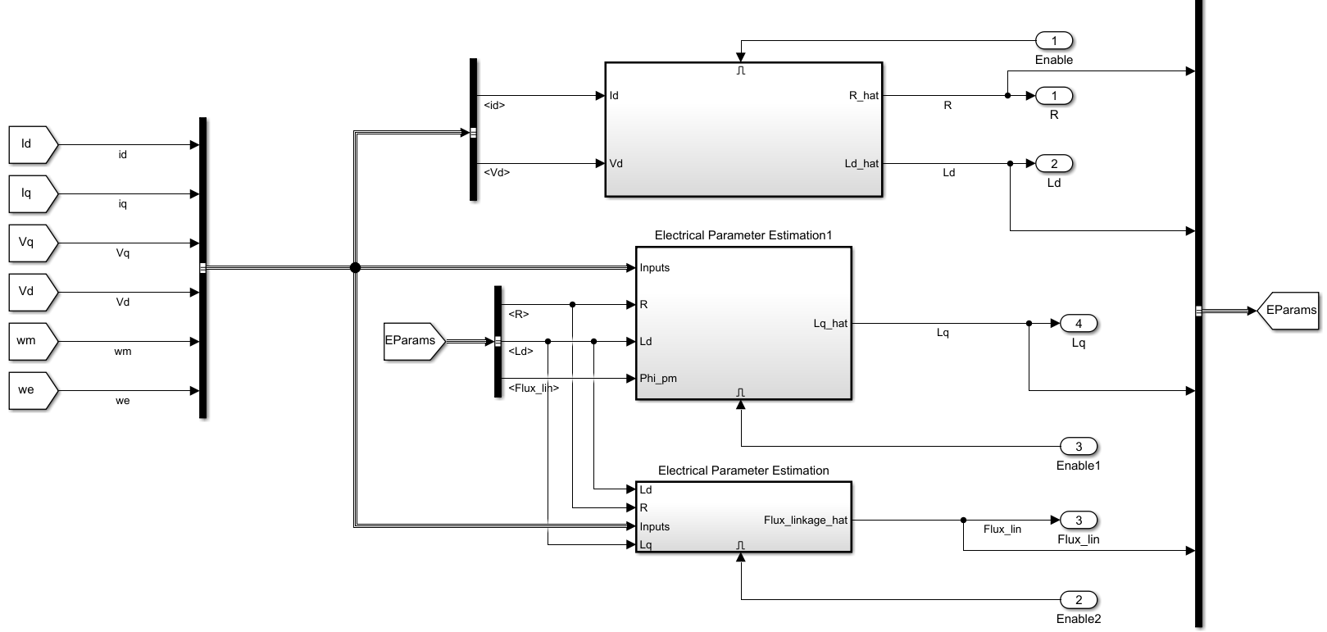

Slide 14
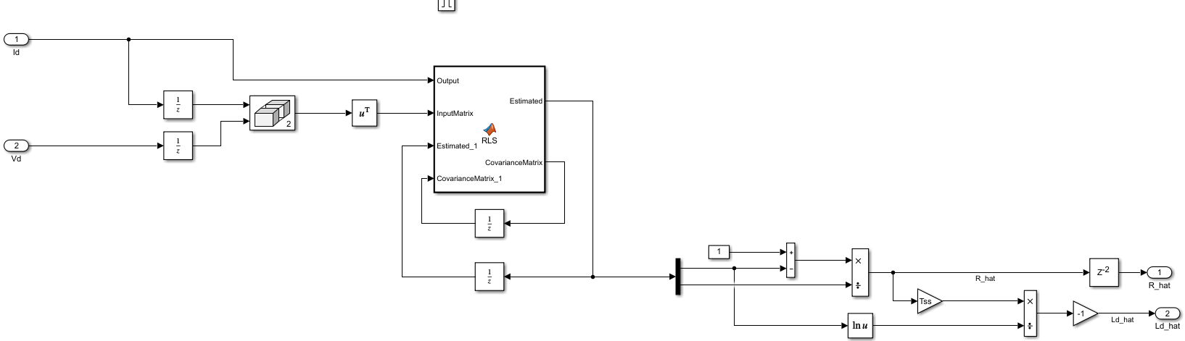
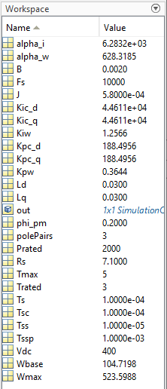
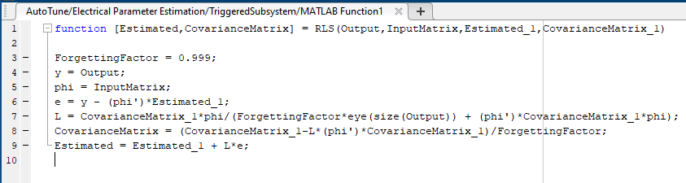

Slide 15
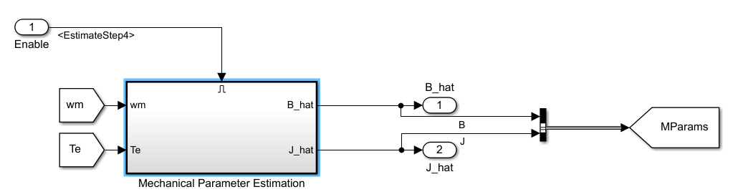
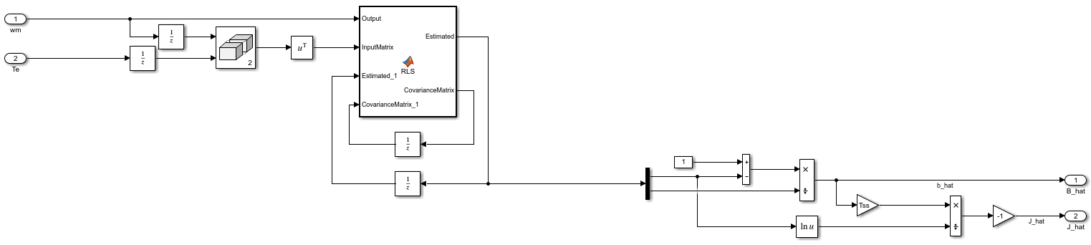

Slide 16
